Slide 1
Gesture Recognition in Dynamic Environments using MAML-DG
Group Number:
28
He Jingge 120090899
Chen Zhilin 120090814
Ma Kexuan 120090651
Wu Dongze 119010337

Slide 2
01
Background & Literature Review
04
Results
05
Contributions
02
03
Significance & Novelty
Algorithm
06
Q & A
Content

Slide 3
Background & Literature Review
01

Slide 4
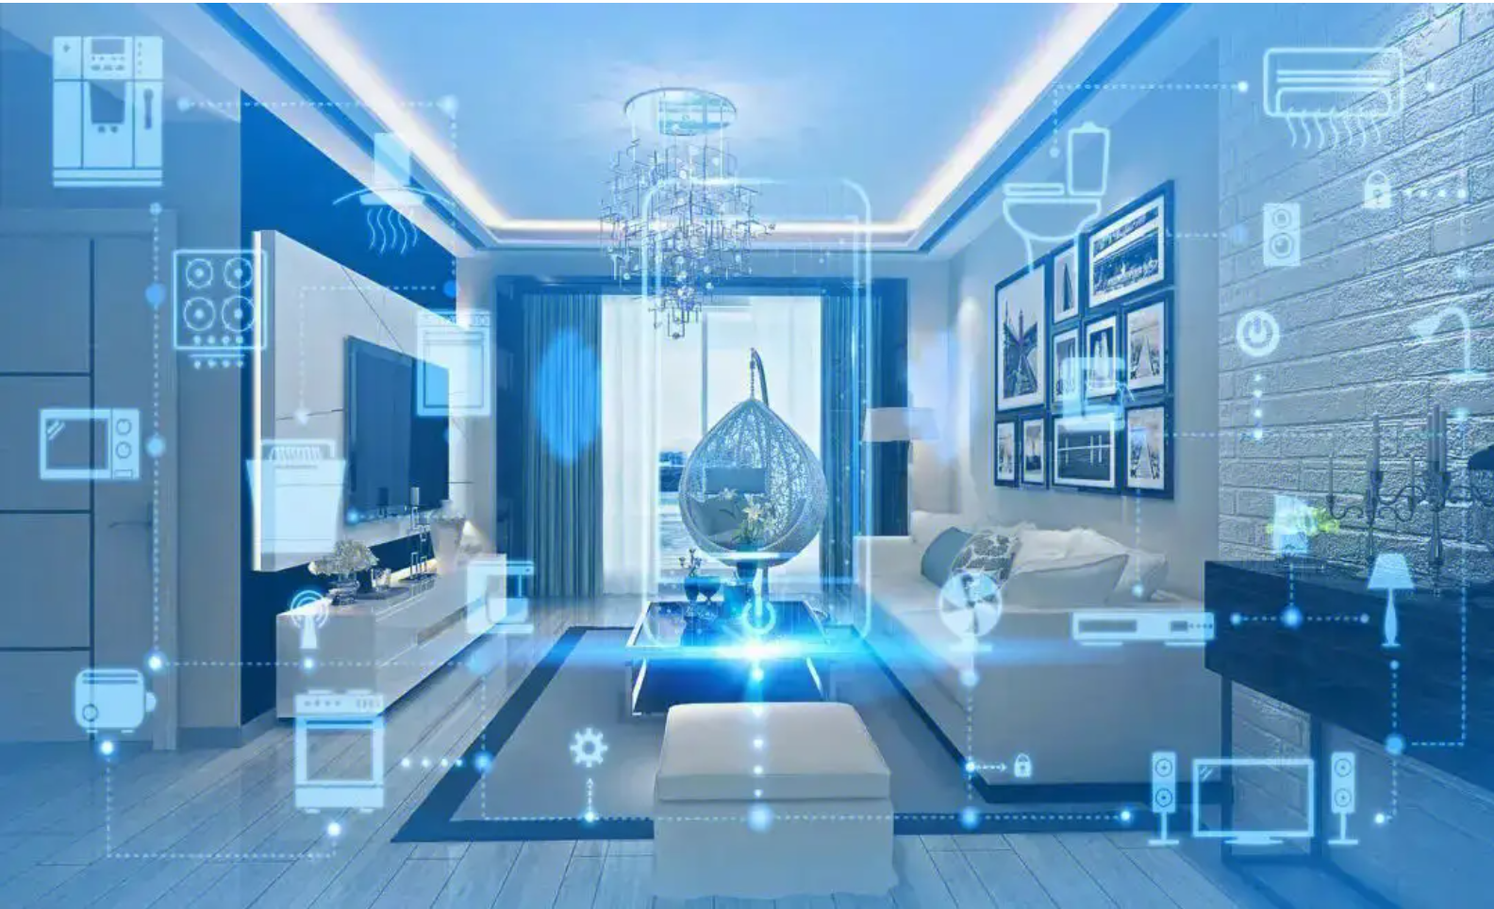

Background
Control everything without touching
Smart homes
Virtual gaming

Slide 5

Background
Analyzing the changes in the Wi-Fi signal caused by the movement of a person’s hand or body to interact with devices without physically touching them.
Wi-Fi Gesture Recognition

Slide 6
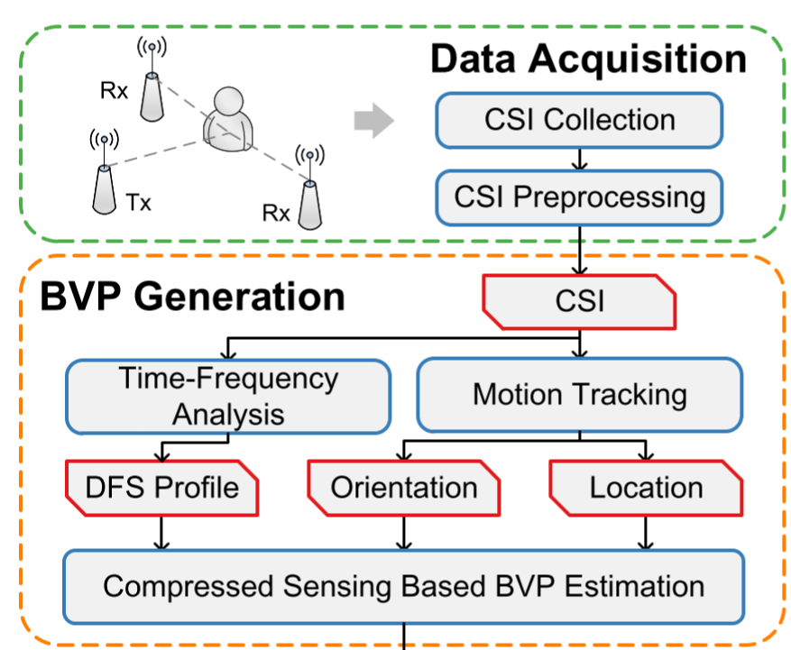
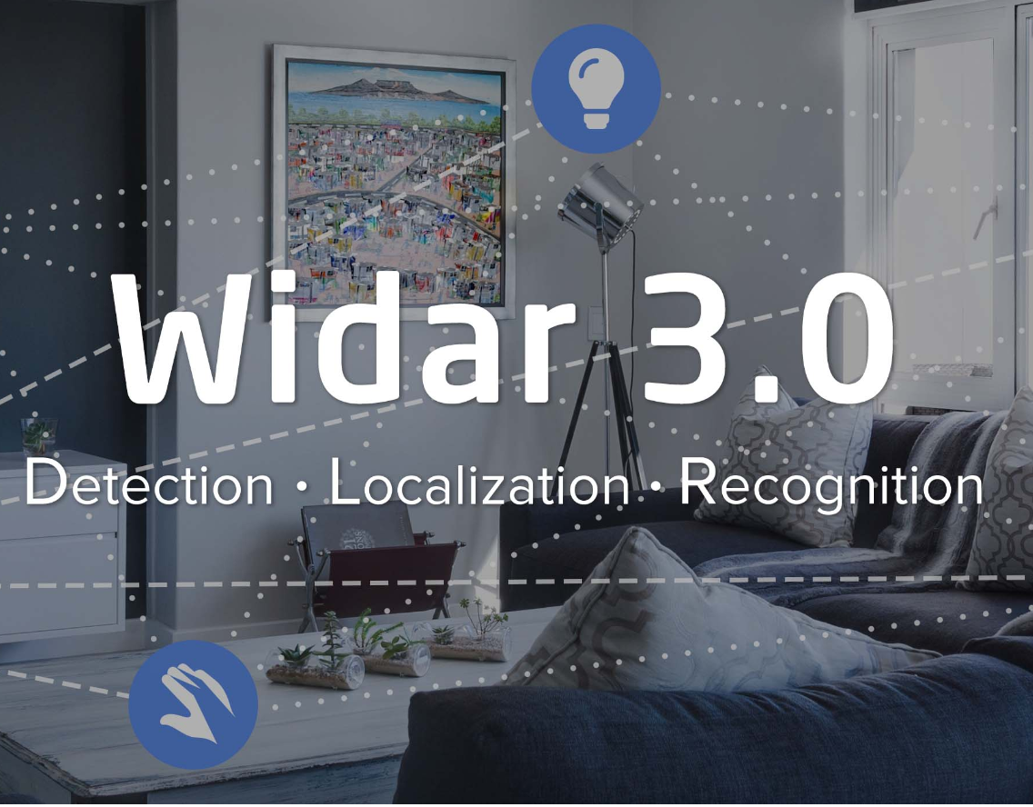
Literature Review
Zero-effort cross-domain gesture recognition system via Wi-Fi, a fundamental step towards ubiquitous sensing
Data Processing

Slide 7
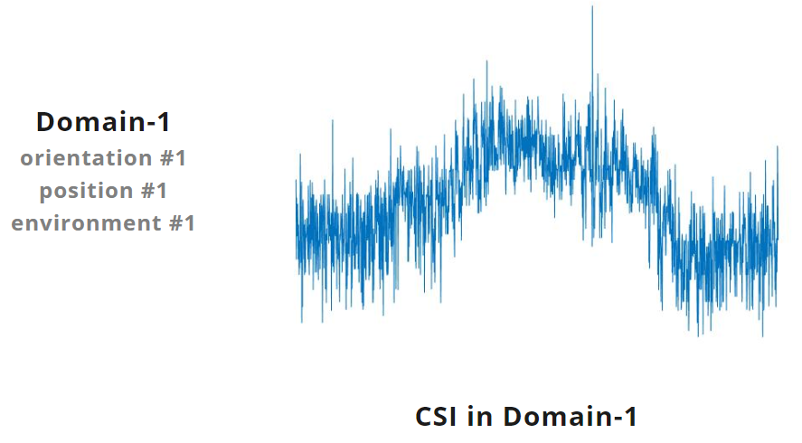
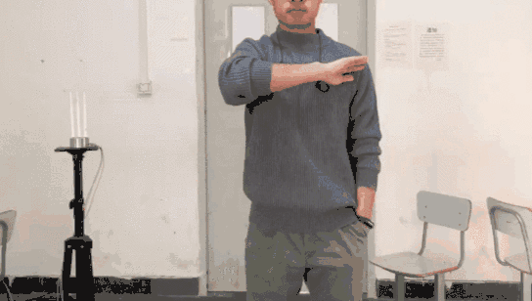
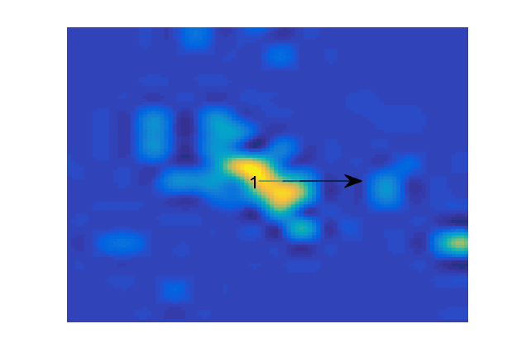
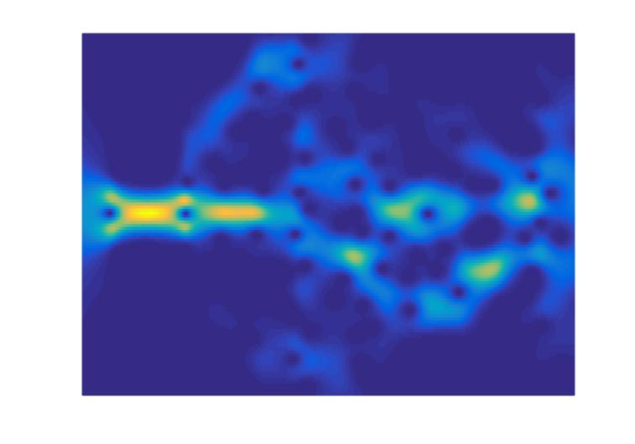
Sweep
BVP in Domain-1
DFS in Domain-1

Slide 8
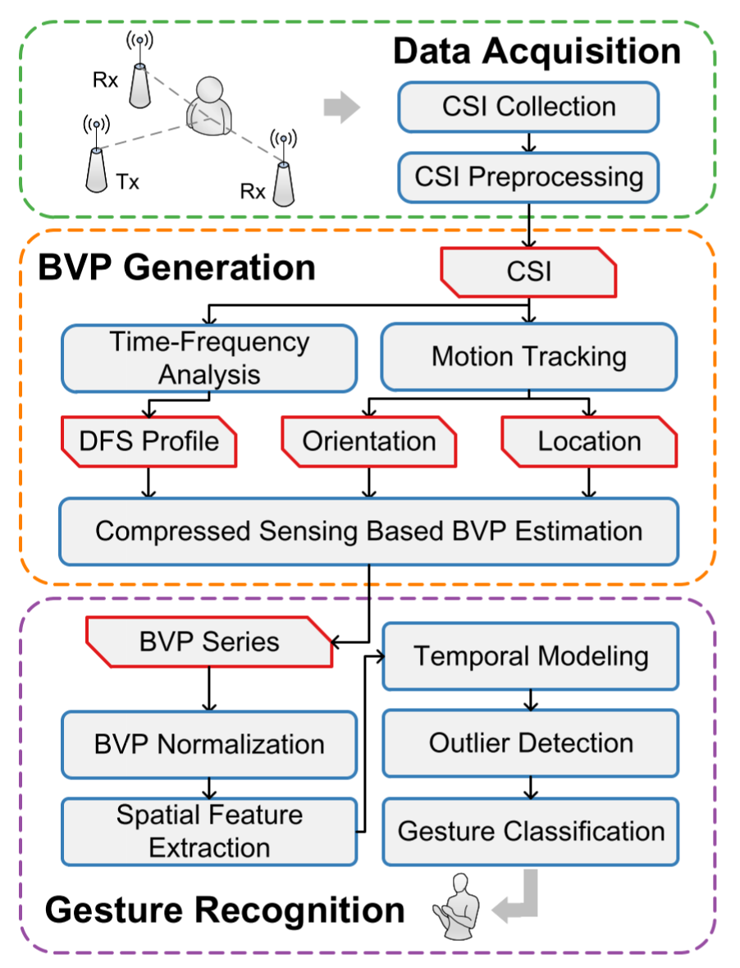

Literature Review
Two Functions
CNN extracts high-level spatial features within each BVP using convolutional layers
CNN adopts recurrent layers to perform temporal modeling of inter-characteristics between BVPs

Slide 9
Significance & Novelty
02

Slide 10






Significance and Novelty
——Mobility of Time
The value of Wi-Fi signal can vary at different times of day
Widar 3.0:
Train on the same day and test on the same day
the number of devices connected to the network
Problem: If testing on a different day, the performance is not satisfying.
the distance between the device and the router
Our Model:
Train and test at different times
interference from other devices or networks
Advantage:
Capture the essential similar characteristics across a sequence of dates
Decrease the influence of time variation

Slide 11
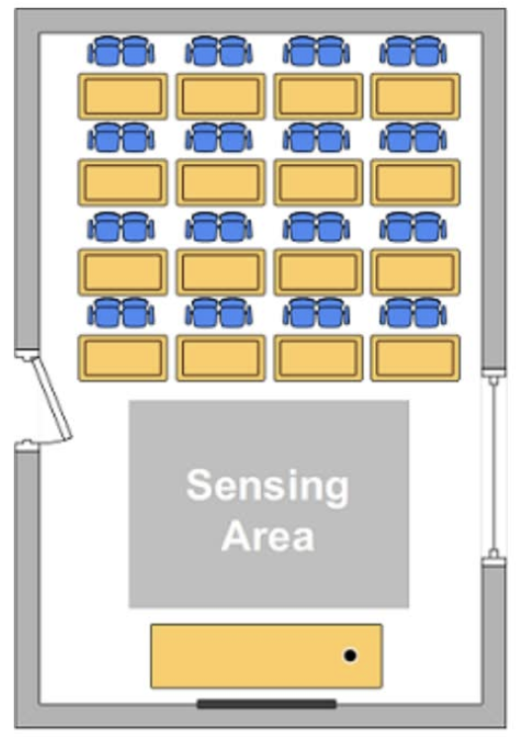
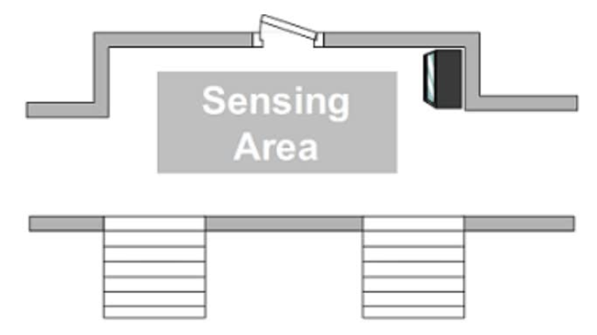


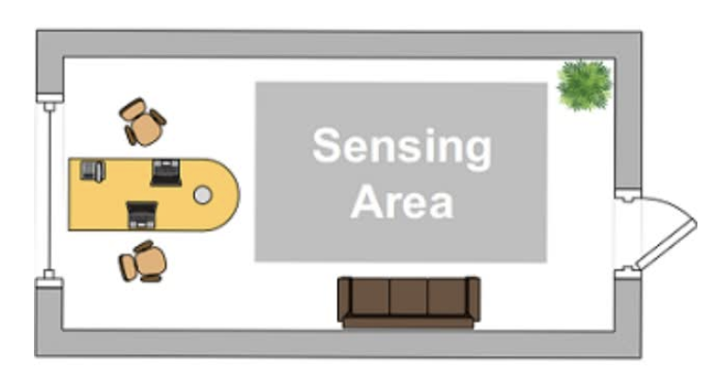


Significance and Novelty
——Efficient Training on Diverse Domains
CNN (Widar 3.0)
——Cross-place Domains
MAML (Our Model)
——Cross-time Domains
Room 1: Classroom
Room 2: Hall
Time 1: Morning
Time 2: Noon
Room 3: Office
Time 3: Evening
Time 4: Night
Cons: Model is not ideal when tested with data points in new environment.
Pros: MAML can train and test more efficiently on the data from the new environment.

Slide 12



Significance and Novelty
——Perform well with limited data in a new environment
Pre-trained
Model
Fine-tuned
Model
New dataset
Fine-tuning
New environment
CNN (Widar 3.0)
MAML (Our Model)
The number of steps for fine-tuning is large
Hard to achieve acceptable accuracy for data points in the new environment
Only THREE data points are enough for a new environment
Higher accuracy and faster convergence
Easy to cope with the problem of limited resources

Slide 13
Algorithm
03

Slide 14
What is a task?
Task
N different labels
K different samples in one label
N Way
K Shot
Support
Set
Query
Set

Slide 15
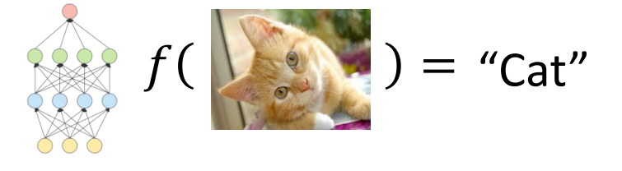
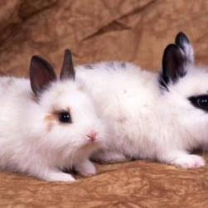
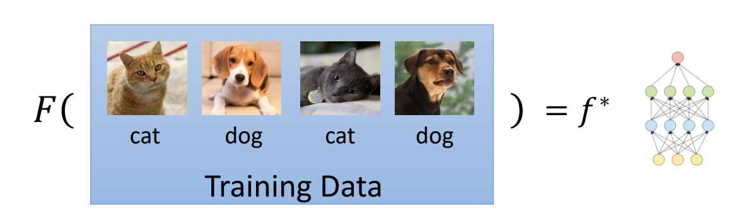
Meta Learning
Machine Learning
Finding a function f according to the given dataset
Finding a function F that can quickly adapt to different test tasks
Meta Learning

Slide 16
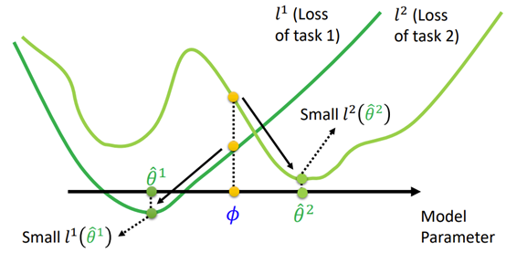

Algorithm——MAML
Goal: To learn parameters that can rapidly converge to global minimum of a new test task

Slide 17
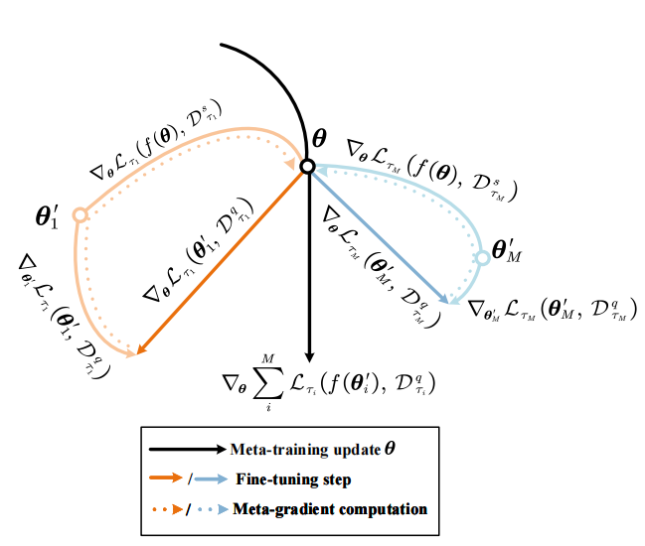
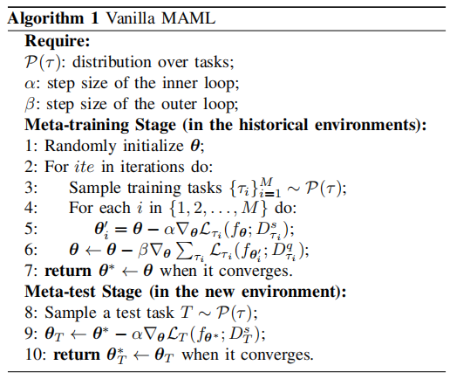
Algorithm——MAML
Outer
Inner
Reference:
C. Finn, P. Abbeel, and S. Levine, “Model-agnostic meta-learning for fast adaptation of deep networks,” in Proc. Int. Conf. Mach. Learn., 2017, pp. 1126–1135.

Slide 18
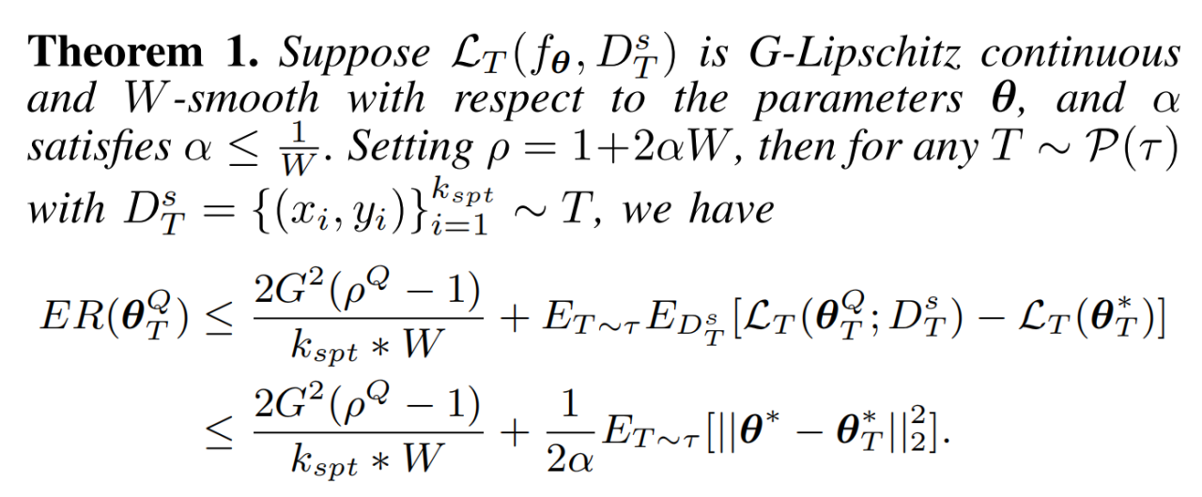
Theoretical Guarantee for MAML
Reference:
P. Zhou, Y. Zou, X.-T. Yuan, J. Feng, C. Xiong, and S. Hoi, “Task similarity aware meta learning: Theory-inspired improvement on MAML,” in Proc. Uncertainty Artif. Intell., 2021, pp. 23–33.

Slide 19
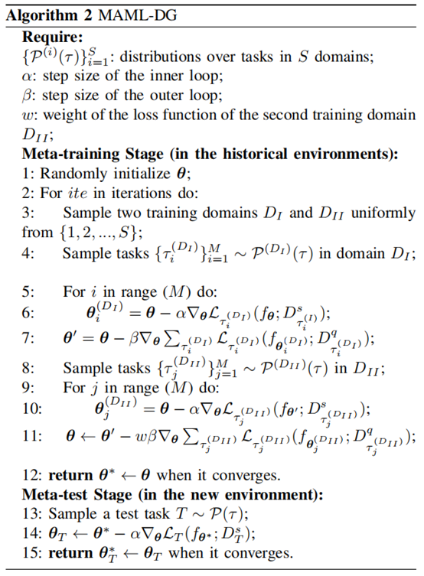
Algorithm ——MAML with Domain Generalization (MAML-DG)
Idea: Mimic the real train-test domain shift
1-3:
Randomly pick out two training domains
4-7:
Virtually train a θ’ through an entire MAML algorithm based on the first domain
8-10 (Mimic the real train-test domain shift):
Treat θ’ as the initialization of the second domain;
Do the fine-tuning on the second domain;
Derive the loss L
By minimizing L, we have guaranteed that the learned θ* can converge to a new test domain very quickly

Slide 20
Results
04

Slide 21
Our Experiments
Training-task format: 3-way; 2-shot for support set; 3-shot for query set
Test-task format: 5-way; 3-shot for support set; 5-shot for query set
Dataset:
CSI images with size 50*50;
The number of labels: 75
The number of environments (dates): 6
Training and Test Procedure:
To test on tasks from date A, we use the data from all other dates for training. Then for the test task from date A, we use its support set containing only 3 samples for each label to do the fine-tuning, and then use its query set containing 5 samples for each label to test the accuracy.

Slide 22
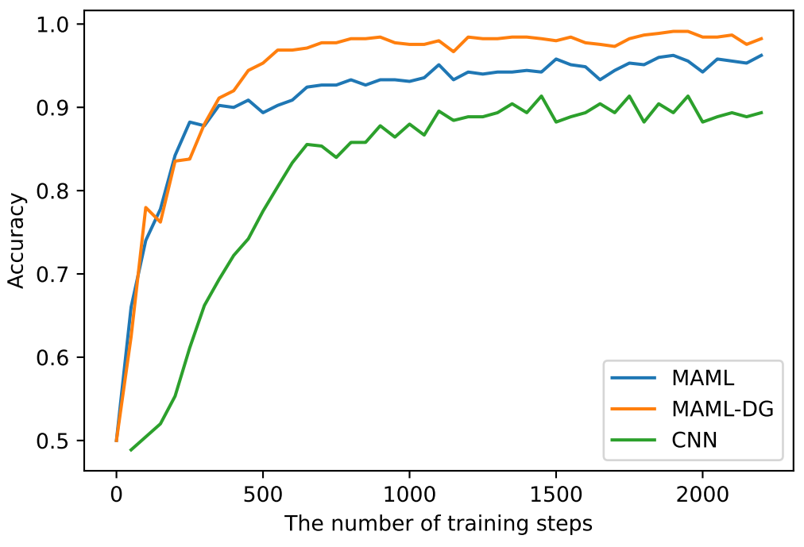
Results
MAML-DG demonstrates the best performance (Accuracy > 95%)
MAML is inferior to MAML-DG, but the accuracy is still high
The performance of CNN is the worst
CNN requires larger training steps to converge
(Here we did the fine-tuning to CNN on a large amount of data!)
Figure 1

Slide 23
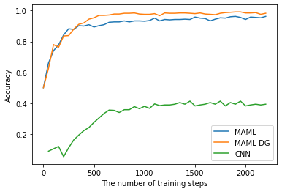
Results
The CNN is fine-tuned on only 3 data points per label
(MAML and MAML-DG are also fine-tuned with 3 data points per label)
Figure 2

Slide 24
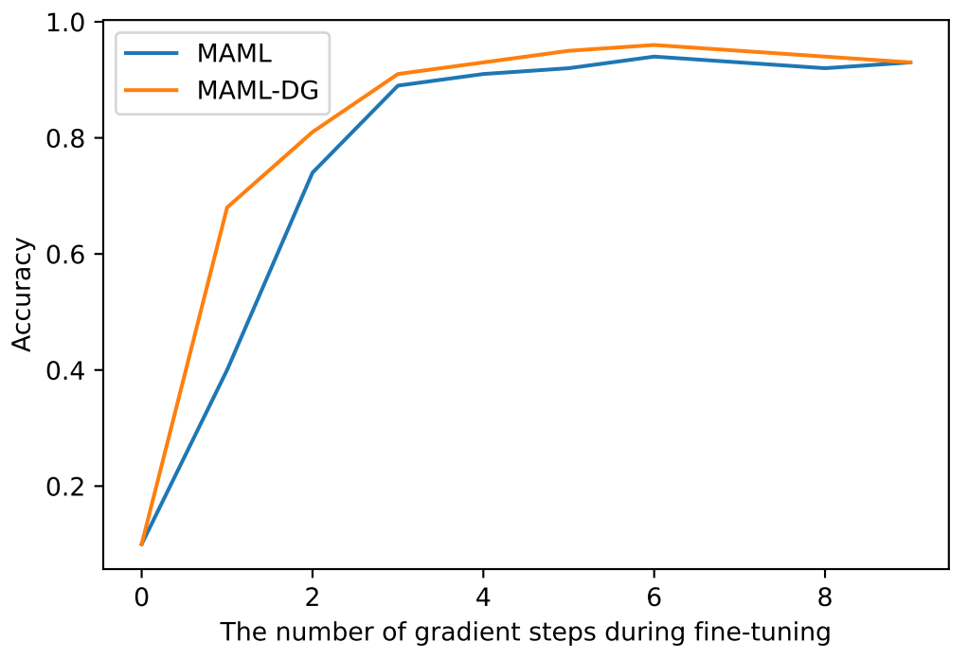
Results
MAML and MAML-DG require only 4 gradient steps during fine-tuning to achieve satisfactory accuracy
MAML-DG can achieve faster convergence compared to MAML
Figure 3

Slide 25
Contributions
05

Slide 26
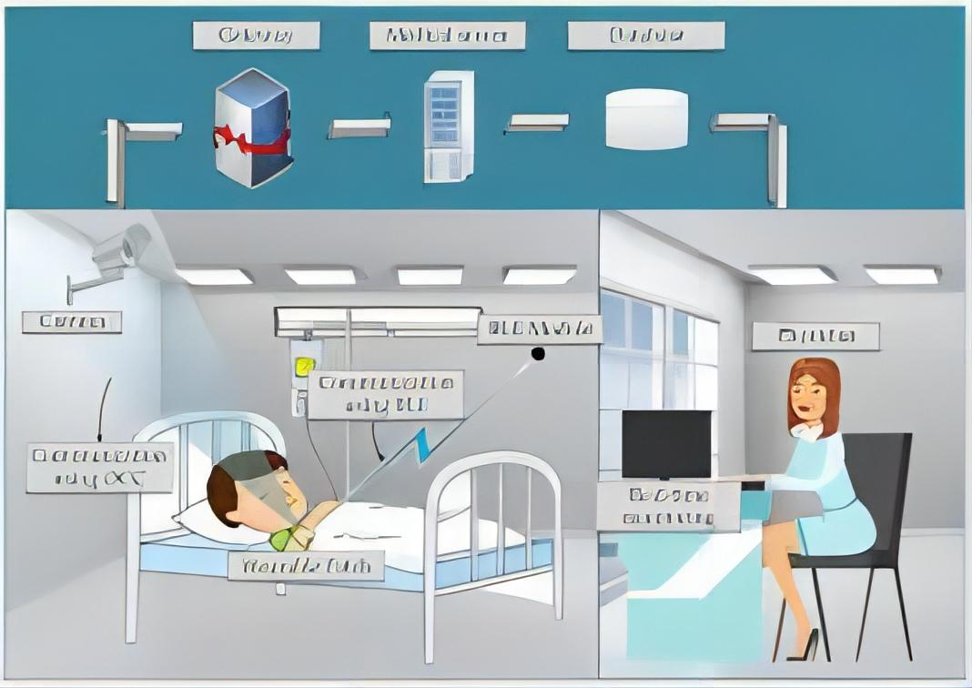
Contributions
1. Applied MAML to the Widar dataset——perform well in different environments with minimal fine-tuning data
2. Developed a new algorithm: MAML-DG, which requires fewer training steps to converge and achieves better adaptation abilities than the original MAML algorithm
3. Promising prospects! (e.g., smart homes, virtual gaming, and health monitoring)

Slide 27
References
1. Y. Zhang, Y. Zheng, K. Qian, G. Zhang, Y. Liu, C. Wu, Z. Yang "Widar3.0: Zero-Effort Cross-Domain Gesture Recognition With Wi-Fi", IEEE TPAMI, 2021.
2. Y. Zhang, Y. Zheng, G. Zhang, K. Qian, C. Qian, Z. Yang "GaitSense: Towards Ubiquitous Gait-Based Human Identification with Wi-Fi", ACM TOSN, 2021.
3. C. Finn, P. Abbeel, and S. Levine, “Model-agnostic meta-learning for fast adaptation of deep networks,” in Proc. Int. Conf. Mach. Learn., 2017, pp. 1126–1135.
4. P. Zhou, Y. Zou, X.-T. Yuan, J. Feng, C. Xiong, and S. Hoi, “Task similarity aware meta-learning: Theory-inspired improvement on MAML,” in Proc. Uncertainty Artif. Intell., 2021, pp. 23–33.

Slide 28
Q & A
06

